Slide 1
Practical Information Risk and Security Practices – Boot Camp March 28 to March 30, 2019

Slide 2
Lets Get Rolling !!
House Keeping
Course Objectives
Format of the Course
Modules
Bringing it Together
Feedback

Slide 3
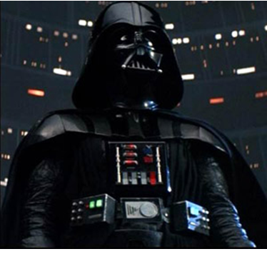
Beware
“But beware of the dark side”
Yoda – 1980

Slide 4
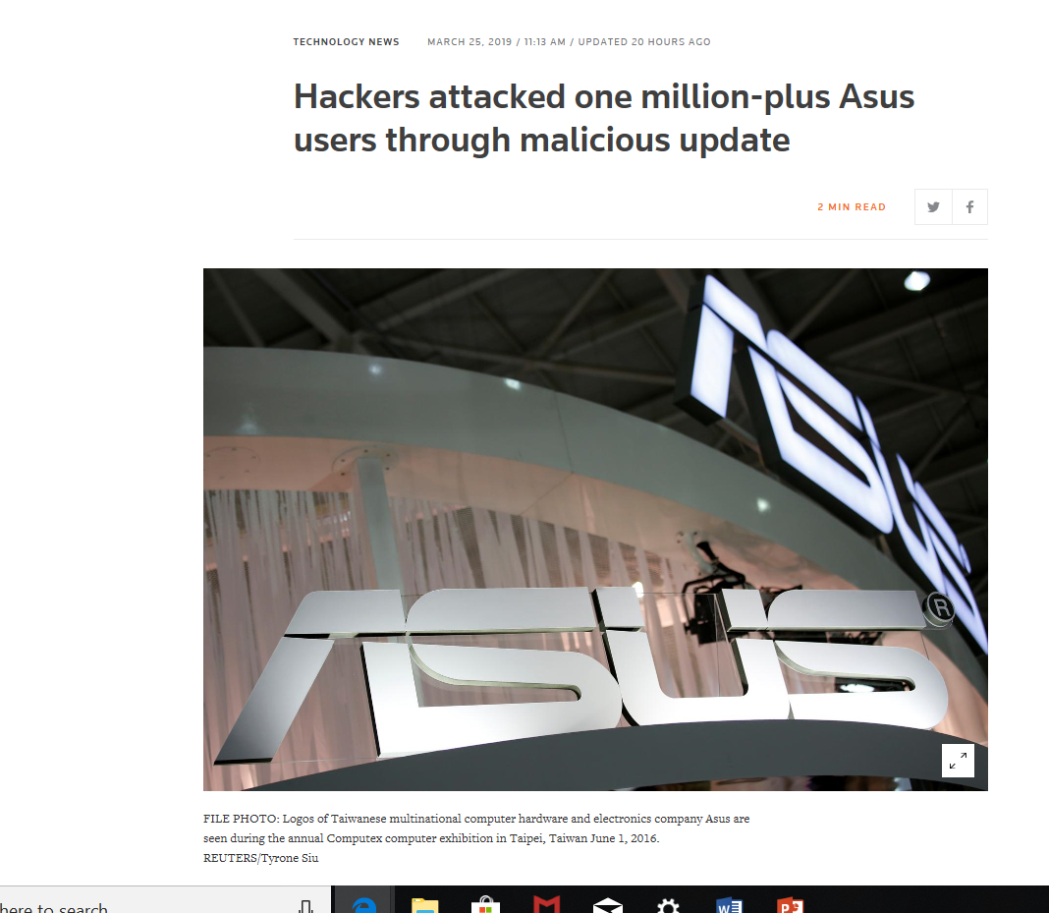
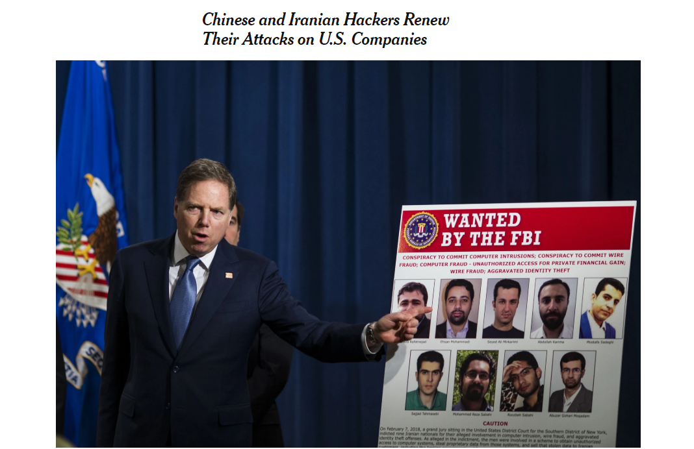
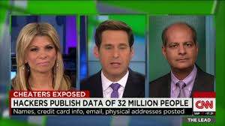
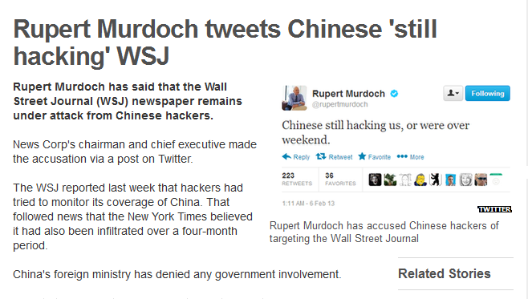
Security in the News

Slide 5
Your Instructors
Ross Boulton
Allen Lum

Slide 6
Course Format
9 Modules
Each Module will have 40 to 50 minutes Lecture followed by a 2 hour hands on Lab Session – Team
Lecture Hall and ULM Computer Lab

Slide 7
Modules
Introduction and Engagement Planning
Risk Assessments and Lab
Social Engineering and Lab
Artificial Intelligence and Lab
Application Security and Lab
Security Policies and Procedures
Reporting

Slide 8
Ethics
Information obtained from a client is considered confidential and not to be released out-side of your immediate work group.
Never Scan an IP address without permission from the owner or organization.
Follow all laws dealing with data privacy.
Do not BRAG about your technical skills – doing a good job is the best way to get recognized by your peers
All you have is your reputation. Don’t Destroy it !!

Slide 9
Objectives
Experience Information Risk and Security by getting fully immerse.
Develop skills that you can take to a potential employer and get hired.
Learn how to conduct an Audit/Risk/Security review ( Not An Attack and Pen) and report the results.
Learn an industry standard methodology
Learn to work as a team and to use your peers as a Resource.
Have Fun !

Slide 10
Course Deliverable
You will execute a Security Assessment against a fictitious company which is realistically based. As in a security engagement you’ll need to develop several deliverables for your client. These will include:
Engagement letter which will include scoping and the tasks to be performed
Rules of Engagement
Results of your testing
Final Report

Slide 11
House Keeping
Hours 8:30 - 9:30
9:30 - 9:45 - Break
9:45 - 12:00
Lunch: 12:00 – 1:00
1:00 – 2:15
2:15 – 2:30 - Break
2:30 – 3:30
3:30 - 3:45 – Break
3:45 - 5.00
Dinner

Slide 12
Questions ?

